Slide 1
Beat Take Home Assignment
Kashika Jain

Slide 2
Agenda
SQL Queries and results
Tableau demand Dashboard

Slide 3
SQL Queries and results

Slide 4
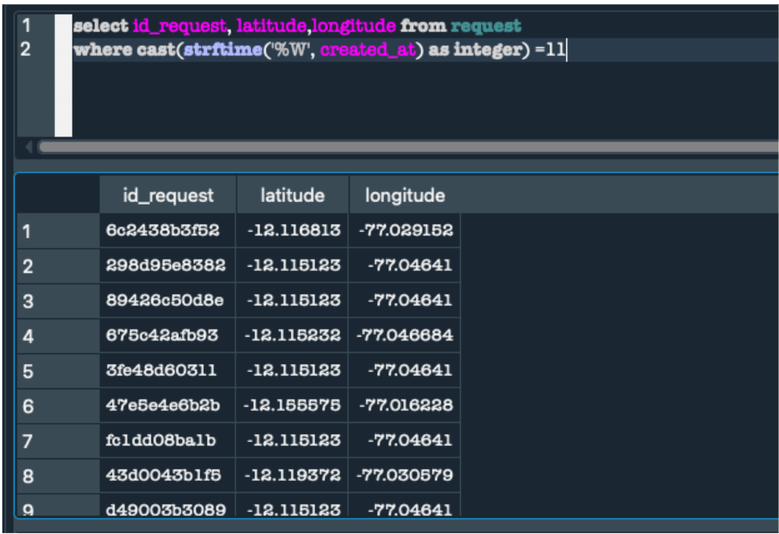
Q1: Provide the latitude & longitude for each id_request.

Slide 5
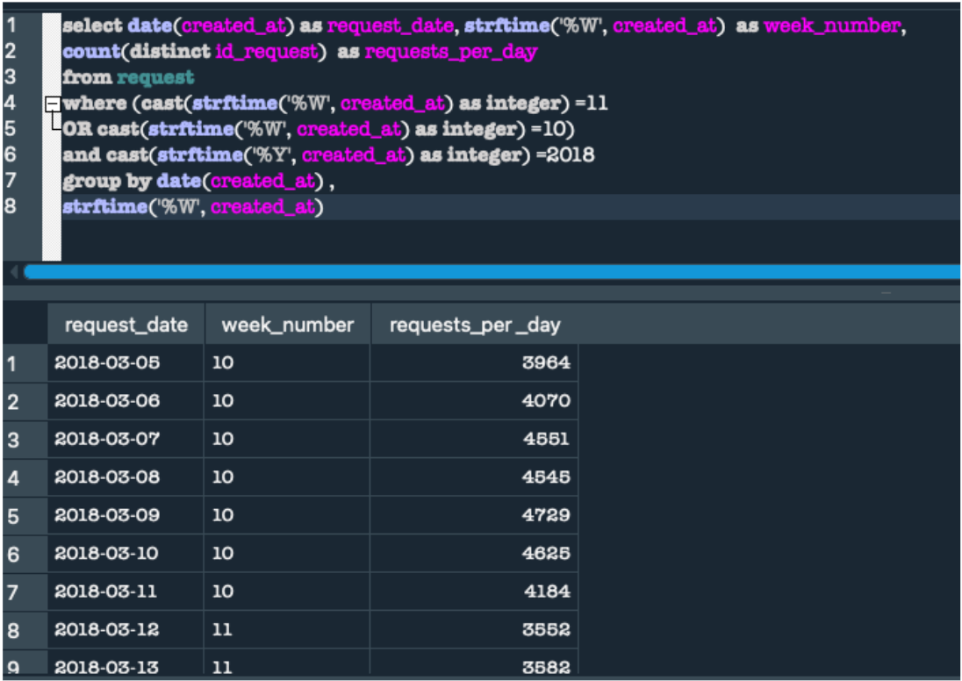
Q2: Solution 1 How many requests per day happened during week 11, 2018 and during previous week?

Slide 6
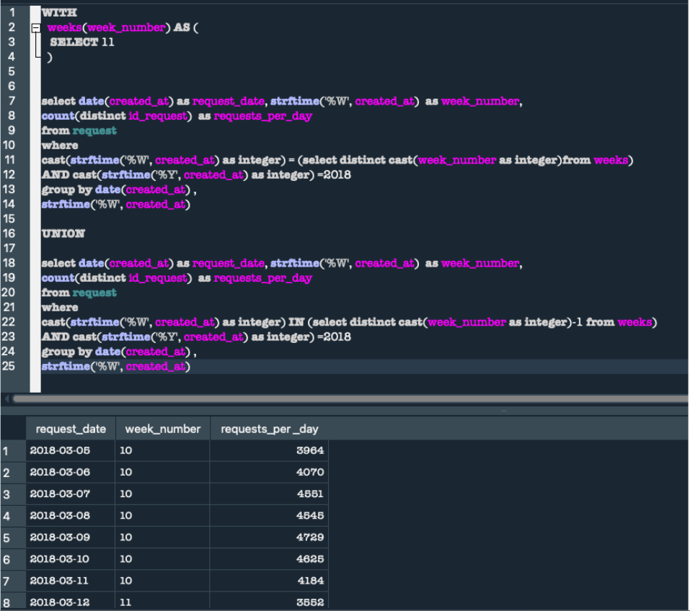
Q2: Solution 2 How many requests per day happened during week 11, 2018 and during previous week?

Slide 7
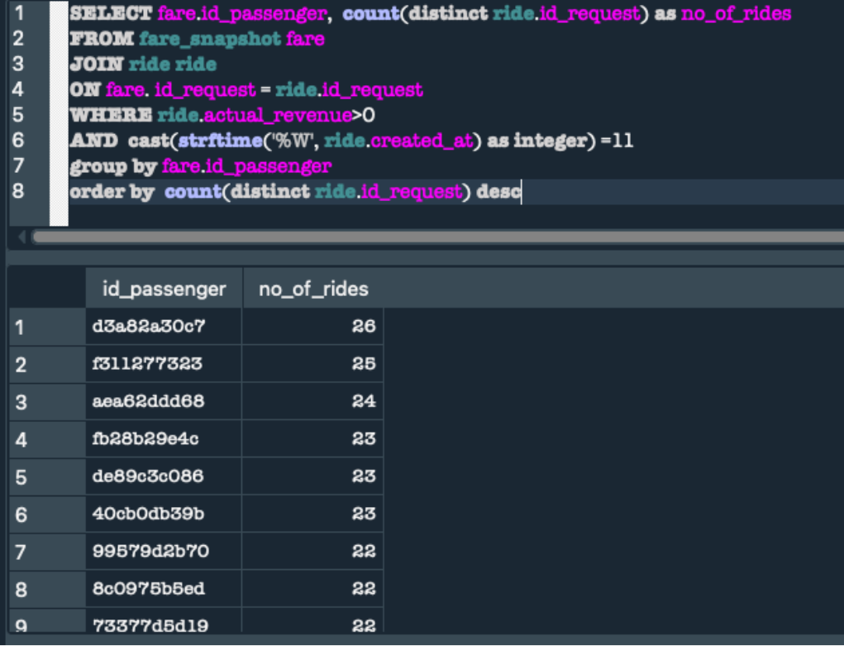
Q3: Provide a list of active passengers sorted descending by volume of rides.

Slide 8
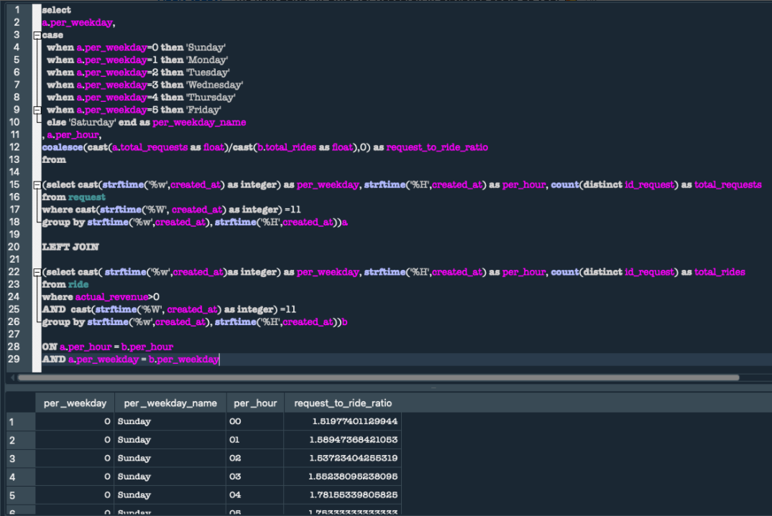
Q4: What was the request to ride ratio per weekday and per hour?

Slide 9
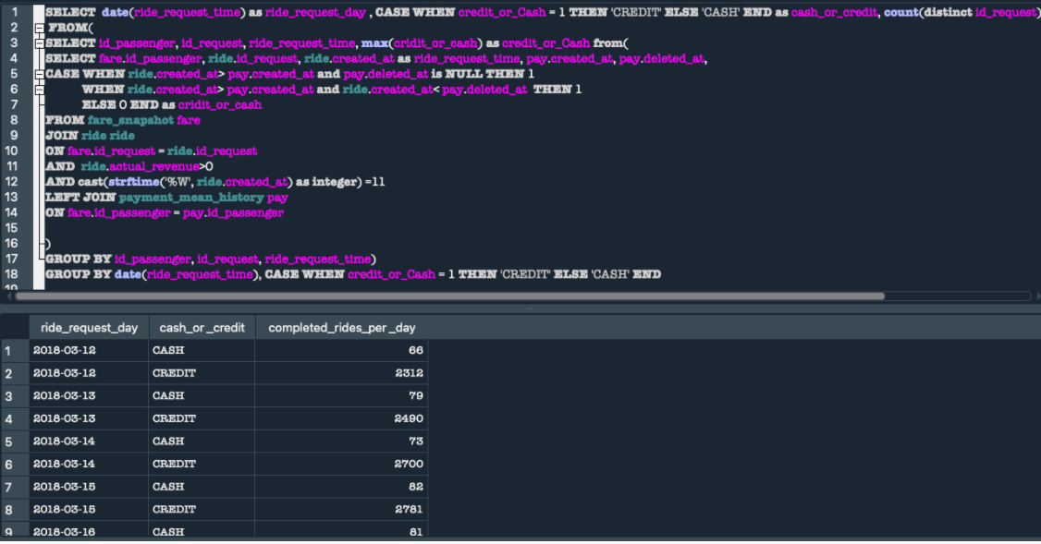
Q5: How many rides per day were completed using cash and how many using a credit card?

Slide 10
Tableau Demand Dashboard

Slide 11
Tableau Demand Dashboard
Things to note
Visualization is added for each question with appropriate comments
The data in Tableau is extracted, live connection can also be used depending on the use case
The tableau workbook has been shared with the assignment
Refer screenshots wherever applicable

Slide 12
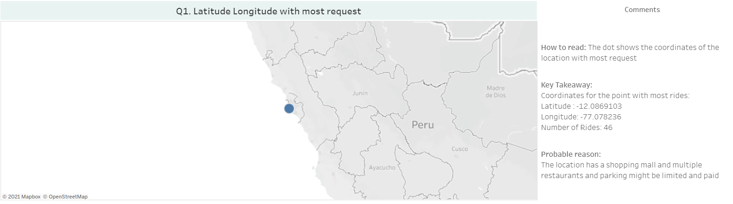
Question 1 Provide a latitude, longitude combination where most requests happened. Which building in the area might explain the high requests’ volume?

Slide 13
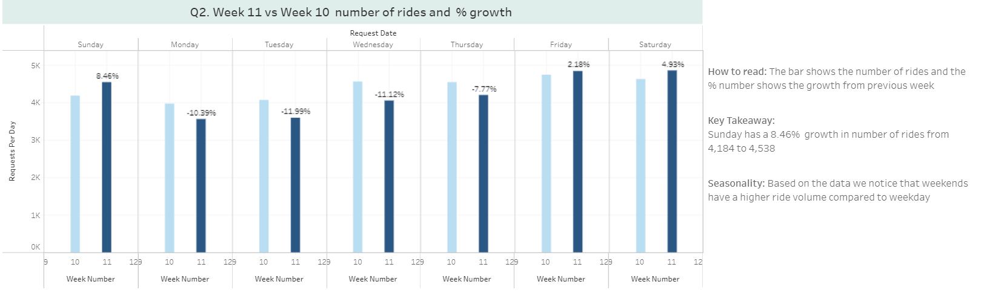
Question 2 Which weekday of week 11 had the biggest growth when compared to the same weekday of week 10? Can you notice any seasonality in terms of requests volume?

Slide 14
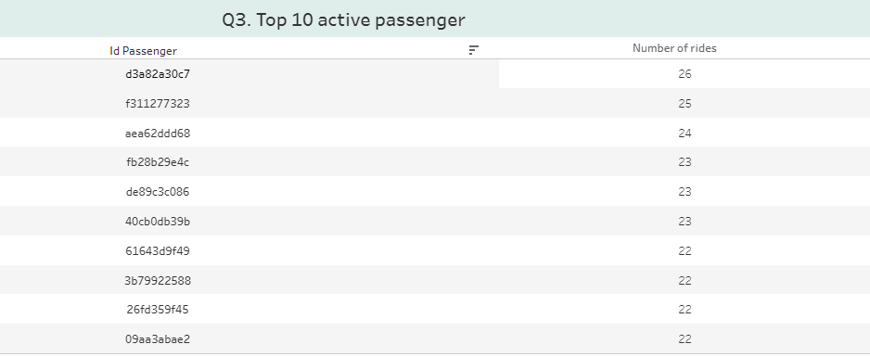
Question 3 Which are the top 10 active passengers?

Slide 15
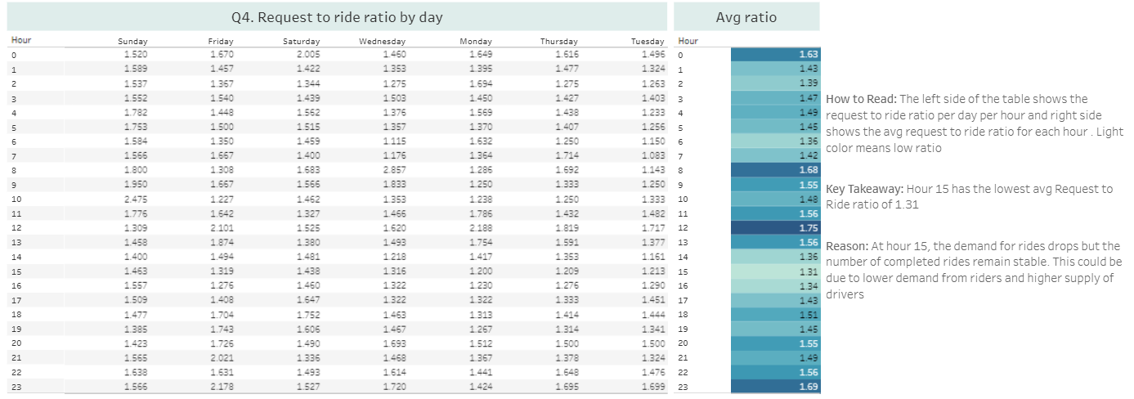
Question 4 During which hours of each weekday of week 11, request to ride ratio was low? Can you provide a possible explanation?

Slide 16
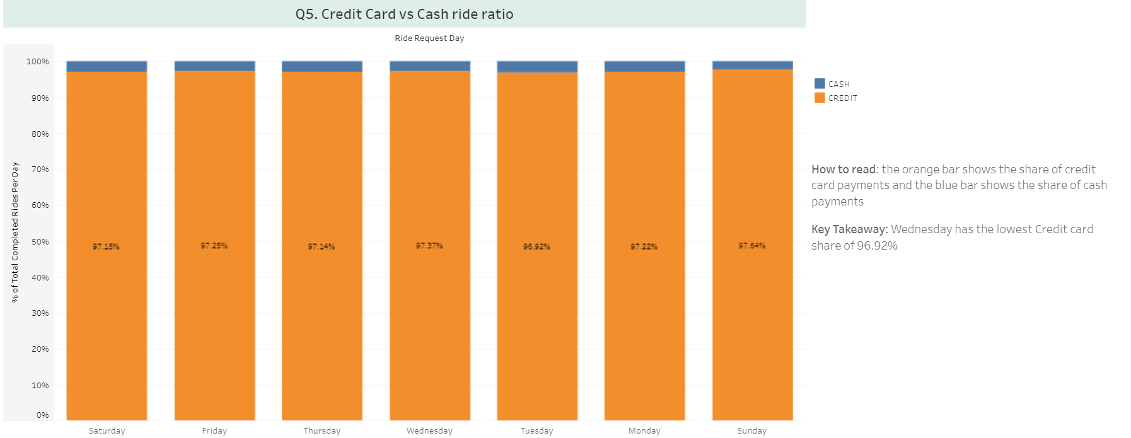
Question 5 Which day had the lowest credit card rides share?

